Slide 1

Project Presentation on “ Social Media Assistant “
Internal Guide :-DHAVAL RAVAL
Presented to: present by:
Department of computer science hritvik.h.sikarwar[17082231119]
janavi.r.patel[170882231055]

Slide 2

1.Project Profile
1.1 Project Title
Project Title : Social Media Assistant
Objective : To Anneliese your Social Media Account
Front End Tool : Android Studio[v3.6.4]
Back End Tool : My SQL [xammpv2.4.41]
Other Tool : 000WebHost,Igblade.
Developed By : Hritvik.H.Sikarwar[17082231119] Janavi.R.Patel[170882231055]
Developed For : Department Of Computer Science
Internal Guide : Dhaval Raval
External Guide : -----

Slide 3



1.2 Objective
The Tool Will Work as an Assistant by Analysis your Social Media Account
The Capability of the Tool is from Personal to Business Accounts
Fast work , Easy to Access , Reliable for Heavy work
Flow Chart for Easy to Analyse
More Secure

Slide 4



2.Requirement Specification
2.1 About Existing System
There are Some of the Tool Available in Market but all of them works Separately which is time Consuming
There are also many Disabilities of them
For e.g. Fake Ghost Followers , Account Blocking
Not Reliable (as it will not working Properly)

Slide 5

2.2 New Features
Monitor The Daily Activities
Flow Chart Availability(new)
Average Values(new)
Safe(new)
User Friendly (new)
All Functionalities in one
(gained , loose , new , etc)

Slide 6
3.Minimum Hardware & Software Requirement

Slide 7

3.1 Client Side Hardware & Software Requirement
Hardware Configuration
Software configuration
Processor | Intel 1.3ghz
RAM | 2 GB(1 GB free space)
Hard drive | 4 GB (1GB free space)
Web Browser | Chrome or any

Slide 8

3.2 Server Side Hardware & Software Requirement
Hardware Configuration
Software configuration
Processor | Intel 1.7ghz
RAM | 8 GB(4GB min. free space)
Hard drive | 1 TB (500 GB free space)
Front End | Android Studio
Back End | SQL, JAVA
Web Server | Chrome or any

Slide 9


4.Function Specification
4.1 User of the System
Admin
End User

Slide 10

4.2 Modules of the System
Admin
Login
Authentication
Password
logout

Slide 11
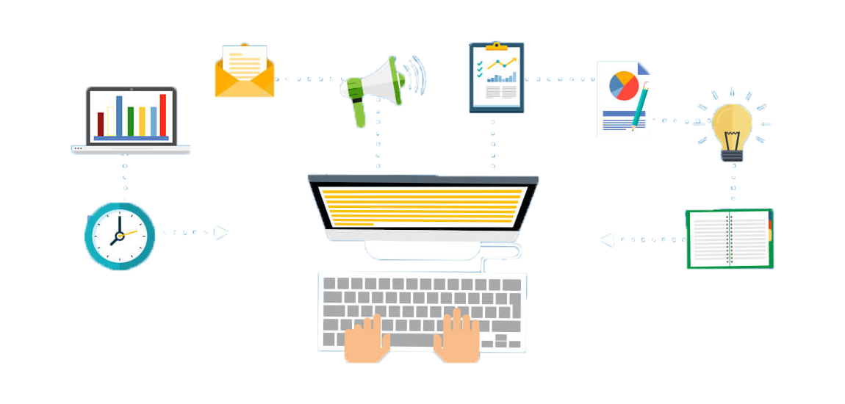
End User
Login
Forgot Password
New User Registration
Functionality (e.g. Gained Followers ,
Loss Followers , Likes ,Comments,
Direct Access to Social Media Account,
Different Charts, Full Over View, and
Many More To explore.)
logout

Slide 12
5.System Flow Chart

Slide 14
6.ER Diagram

Slide 15
Followers Chart
See users Growth
Charts
Following Chart
About Us
Total Posts
Likes Chart
Posts Chart
Followers
Dashboard
Total no. of following
Following
See Quick Overview
Over view
Total no. of followers
Post
User Profile
See Users Account
Total no. of posts
Register new user
Login
Forgot Password
Change Password
Login
First name
Last name
Admin
User
Manage user
Username
D.O.B
Mob No.
Maintain
Manage
Password

Slide 16
7. Data Flow Diagram
Context Level DFD

Slide 17
Admin
Profile
Information
User
Login
Detail
Admin
0.0
SOCIAL
MEDIA
ASSISTANT
User
Admin
Login
Details
User
Profile
Information

Slide 18
DFD (Admin)

Slide 20
DFD (user)

Slide 22
8.Data Dictionary

Slide 23
Table Name : Admin Table Description : Use to store data
Fieldname | Data Type | Size | Constraint | Description
Ad_Id | Int | 4 | Primary key | To store admin id
Ad_Password | varchar | 10 | Not null | To store admin password

Slide 24
Table Name : New User Table Description : Use to store user data
Fieldname | Data Type | Size | Constraint | Description
User_name | varchar | 10 | Unique Key | To Store user’ username
Firist_name | varchar | 15 | Not null | To store user firstname
Last_name | varchar | 15 | Not null | To store user lastname
Birthdate | Date | 8 | Not null | To store user Birthdate
Mo_number | number | 10 | Unique key | To store user mobile number
User_password | varchar | 10 | Not null | To store user Password

Slide 25
Table Name : User Information Table Table Description : Use to store user data
Fieldname | Data Type | Size | Constraint | Description
User_name | varchar | 10 | Unique key | To store user name
Profile_Pic_Url | varchar | 100 | Not null | To store user profile picture url
Post_total | int | 100 | Not null | To store user’s total post
Followers_list | varchar | 100 | Not null | To store User’s followers list
Following_list | varchar | 100 | Not null | To store user’s following list
Bio | varchar | 200 | Not null | To store bio
Profile_url | varchar | 250 | Not null | To store user profile url

Slide 26
9.Process Description (Module Wise)

Slide 27

Social Media Assistant is totally social media based application for analysis your social media account(Instagram)
Social Media Assistant Include:-
Admin Module
User Module

Slide 28
Common process for all module
Registration process
Login Process
Search Process
Registration Process
In This process User and Admin will do registration on that site and if it is registered then it will go directly go for authentication checking
Login Process
In this Process , if user is registered the go for checking valid user it will enter the username and password ,it can change the password of crested user and also view and edit own profile

Slide 29
10.Input/Output Design

Slide 30
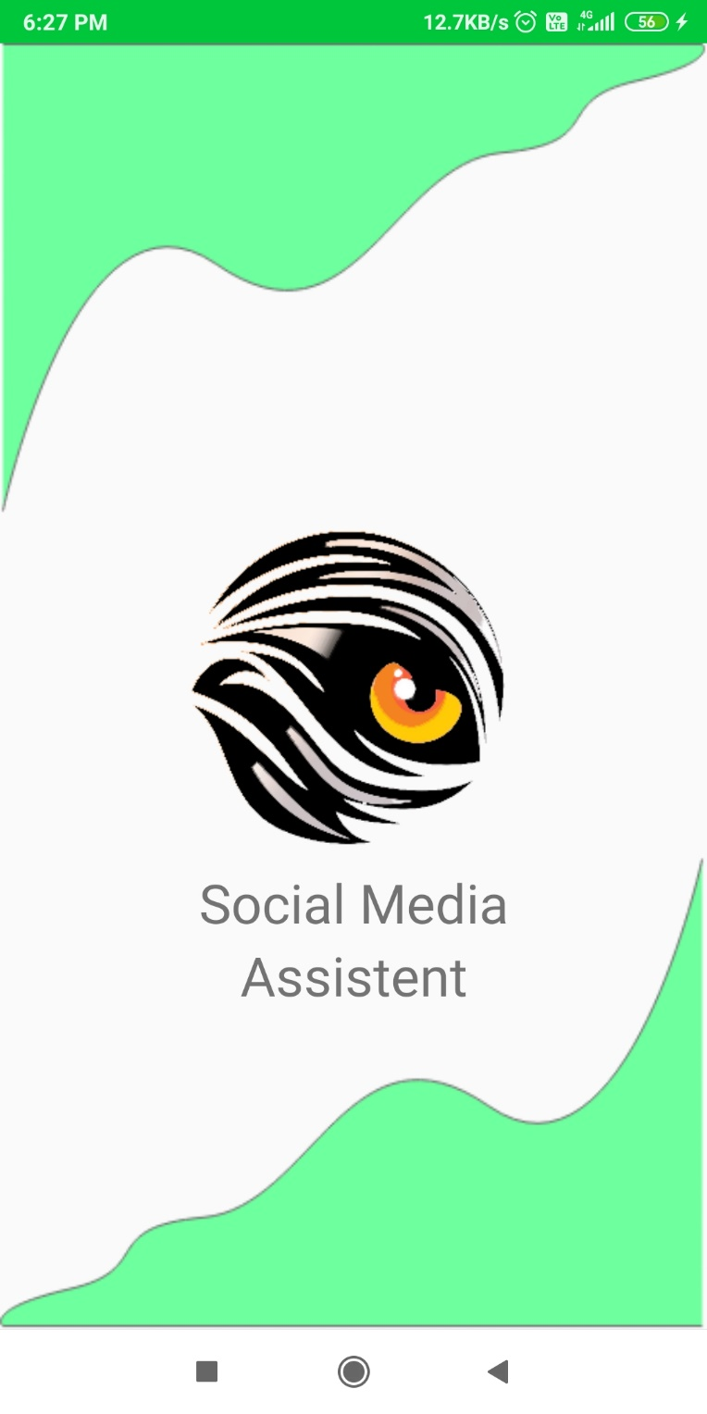
Splash Screen
At the time of Launching of the app the first screen visible to the user is the “Splash Screen”.
It comes with the animated form of splash the logo of the app and its Background
It appears for 2 seconds and then moves to the next Activity

Slide 31
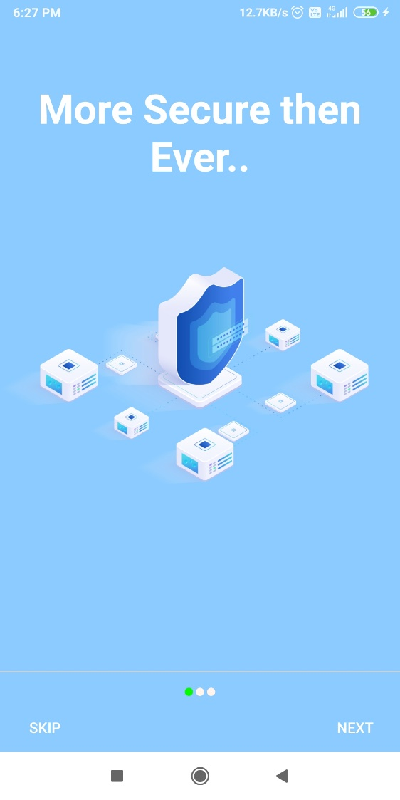
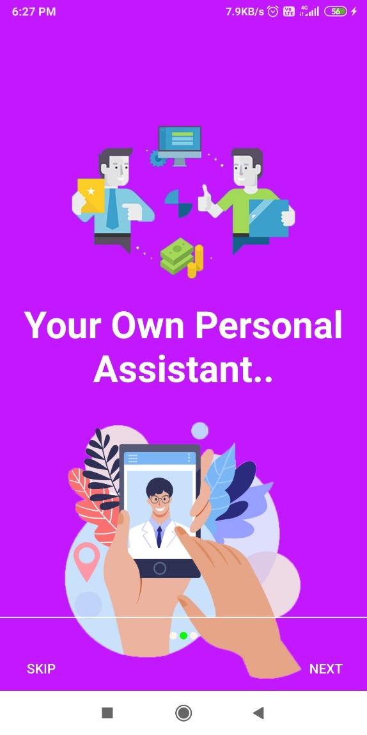
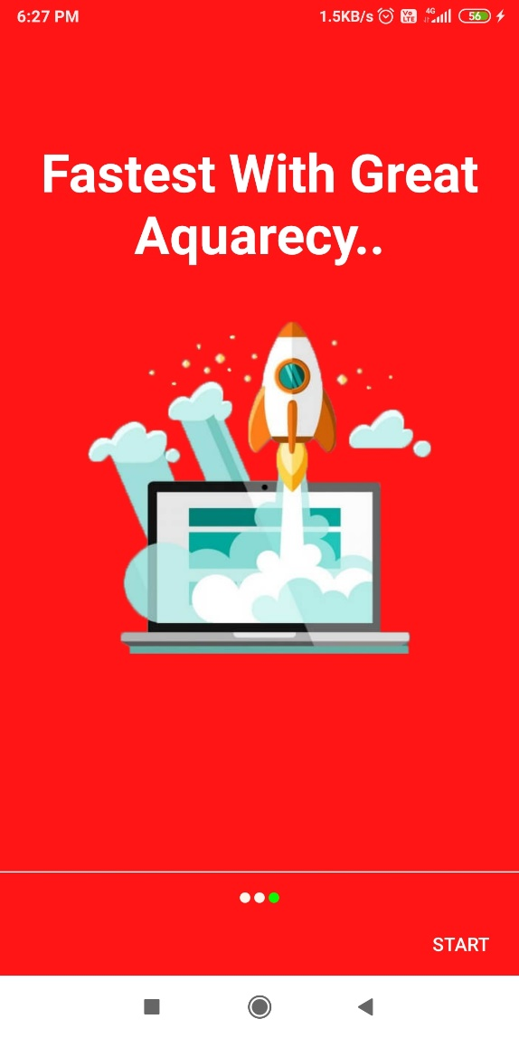
Walk Through Activity
In this activity user come to know the highlighted features of this app.
It is shone only once as the user open the application for the first time.
If ‘NEXT’ then it moves to the next slide
If ‘SKIP’ then it will directly to the Next Activity.

Slide 32
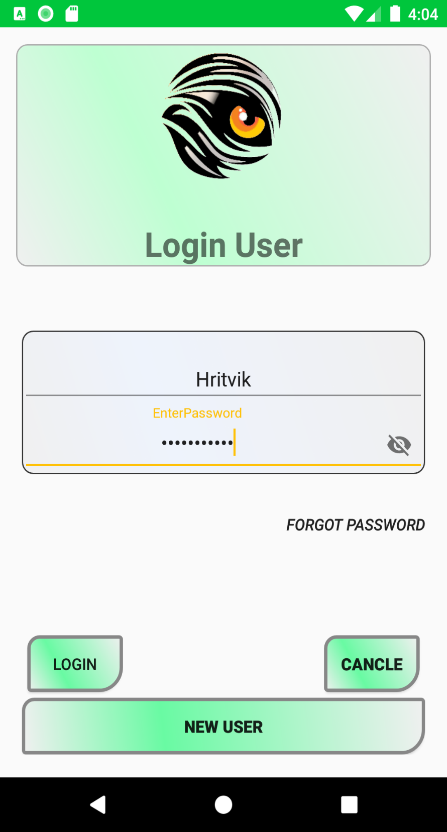
Login Screen
This is the first part where the user can login to there Account.
If the user forgot the Password
To Login
To clear the Boxes
To Register as new user

Slide 33
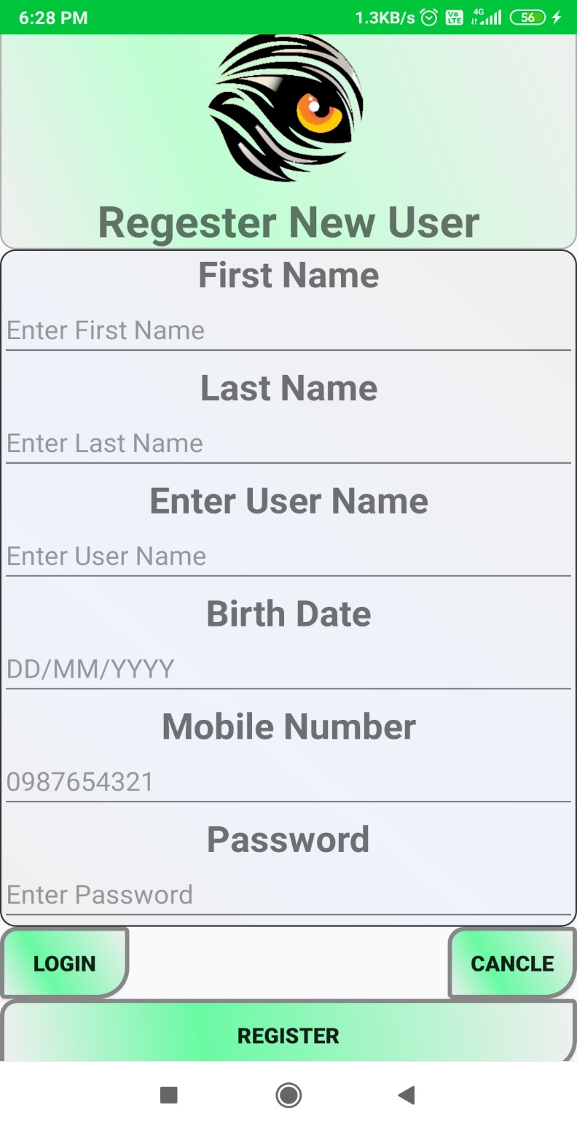
New User Registration
If the user visited for the First time then he/she has fill this activity.
There is a Calendar view which makes it more easy to fill.
Set the username and Password for easy , safe and fast Login

Slide 34
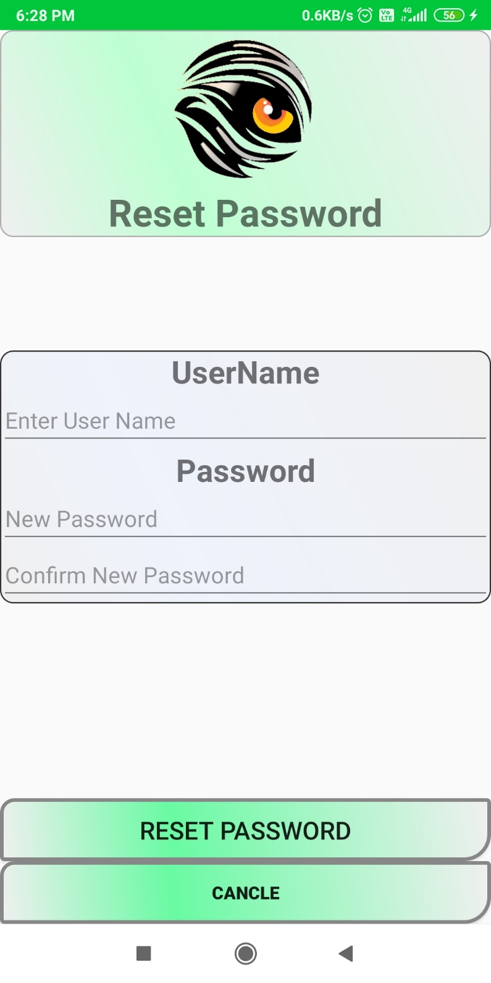
Reset Password
If the user Forgot the Password then by this it can be easily changeable in two steps

Slide 35
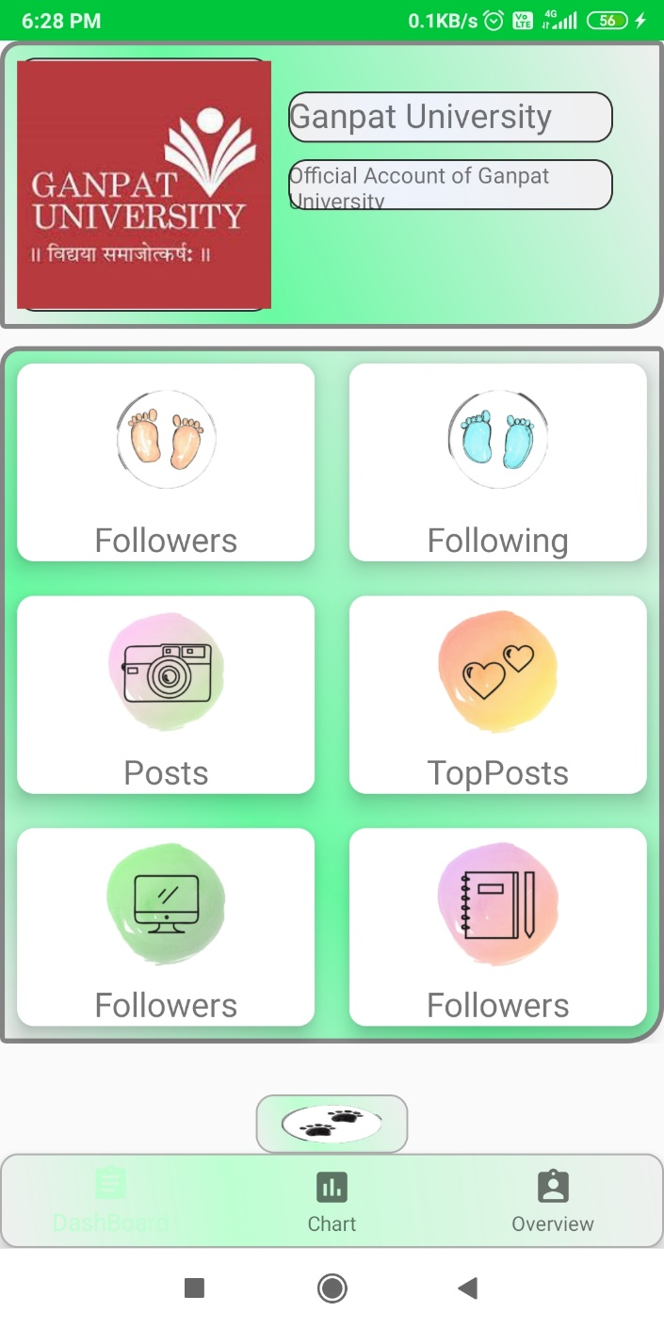
Username
Dash Board
This is the main dashboard of the application.
From here the user can easily monitor his account.
Profile pic
Bio of User
Followers List
Following List
All Posts
Top Posts
User Profile
User profile
About
Dash Board

Slide 36
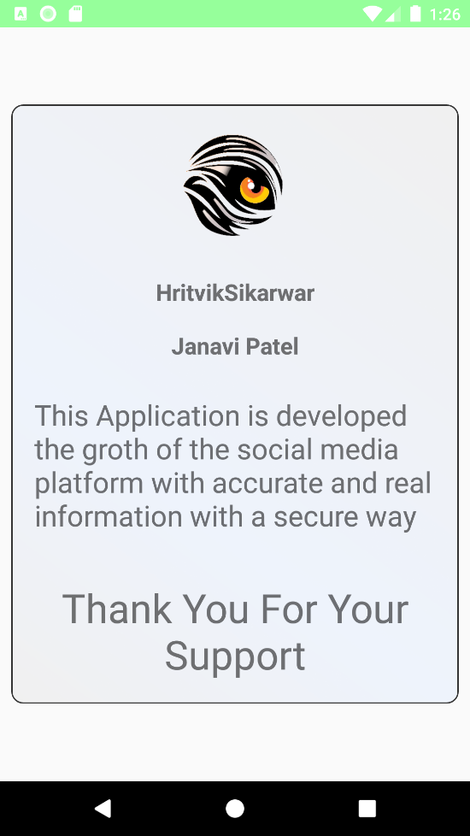

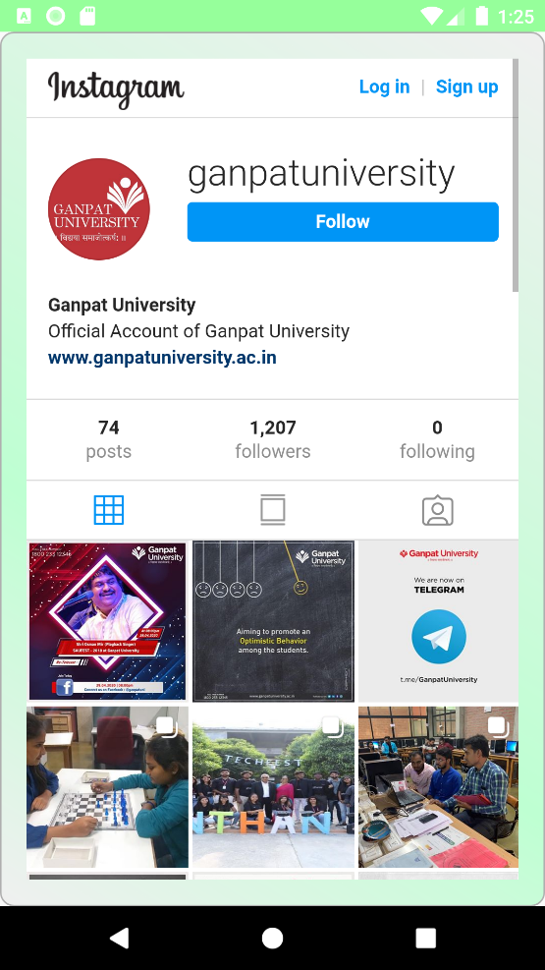
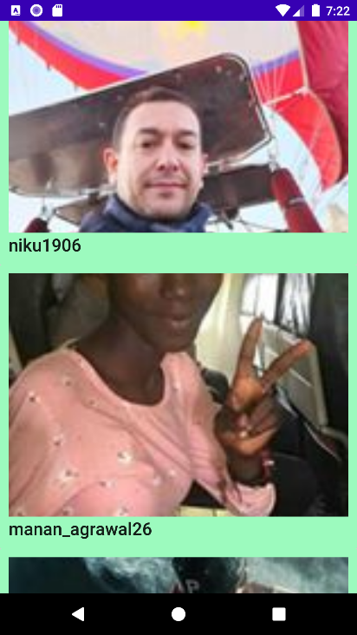

List of Audience With Direct Click and Open his Account Function
Information Of Application
& its Developers
Shows the Most liked Picture
User can Directly Access their Account
About Us
Top Post
User Profile
Followers/
Following List
This is the over view of Functions Of the Application.

Slide 37
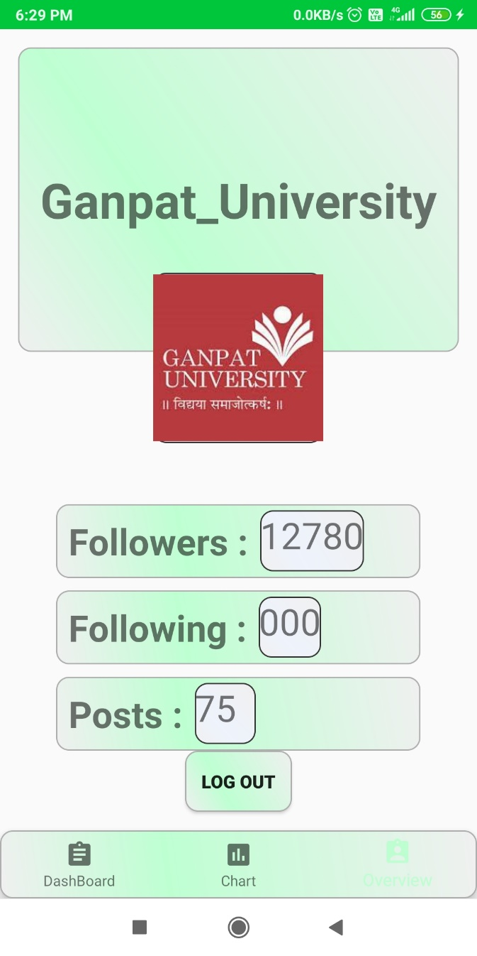
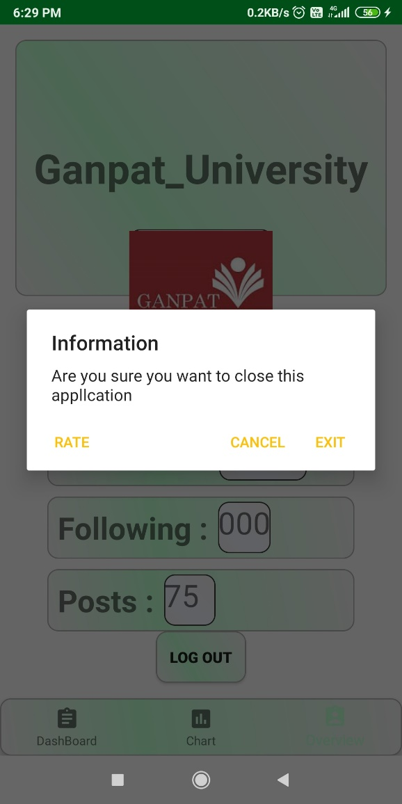
Quick Overview Panel
This Panel Will Show the Count of the account for one click Inspection
Total Followers
Total Following
Total Posts
Logout

Slide 38
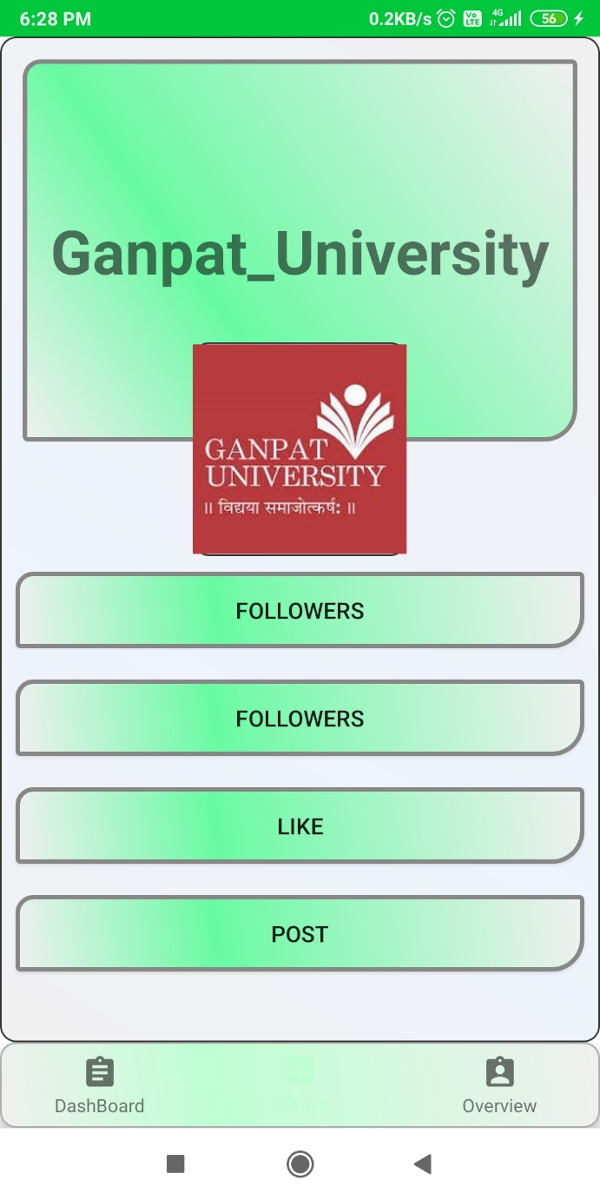
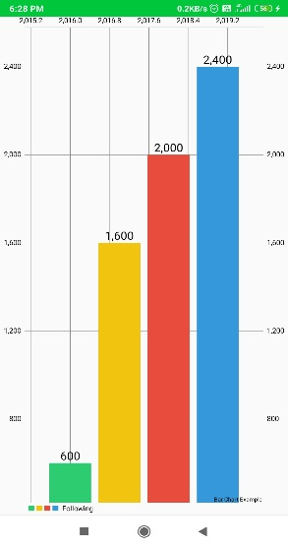
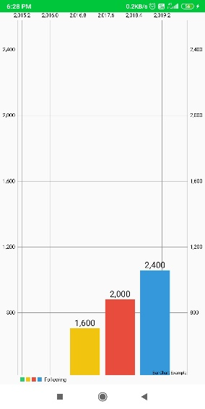
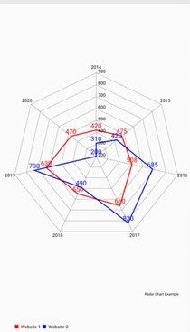
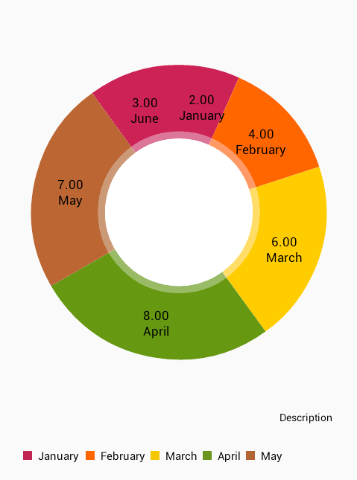
Charts View
The user Friendly Look for Quick Monitoring the account
There are 4 different types of charts for different items with Unique Animations
Bar Chart
Bar Chart
Pie Chart
Radar Chart

Slide 39
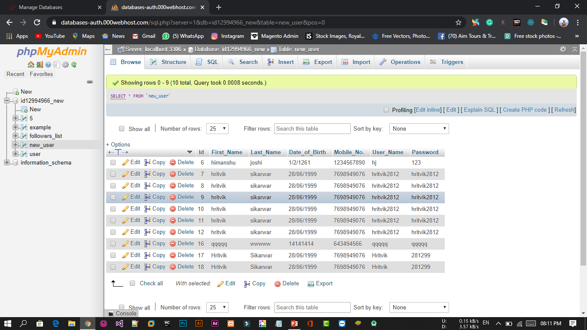
From Here the Admin can manage the users

Slide 40
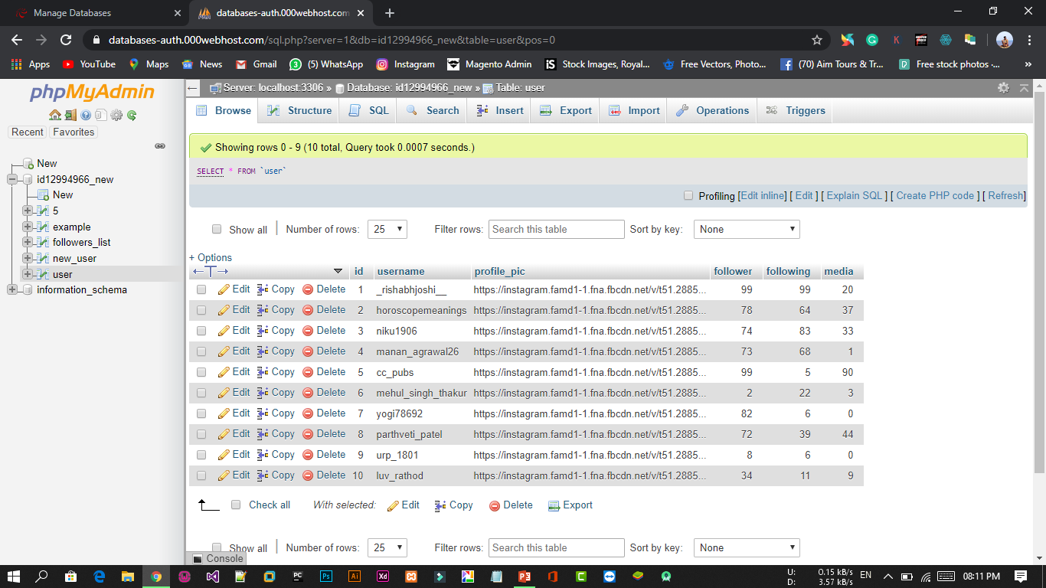
Users Account Information Database Table

Slide 41
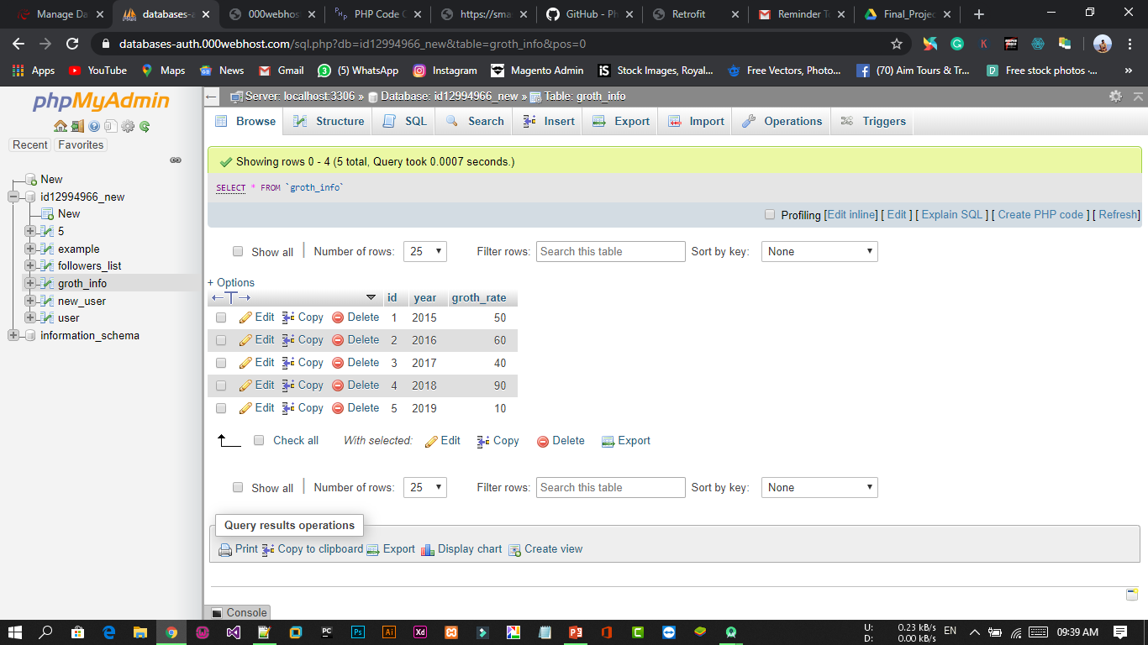
Table for Graph View

Slide 42
11.Testing

Slide 43
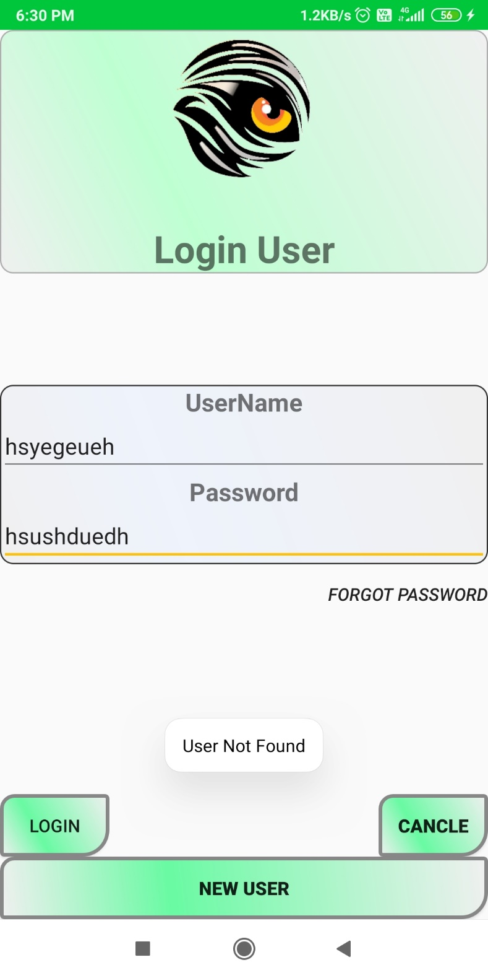
Testing
Any Type of Invalid Format
Or
Unknown User
then a toast popups
User Not Fount

Slide 44
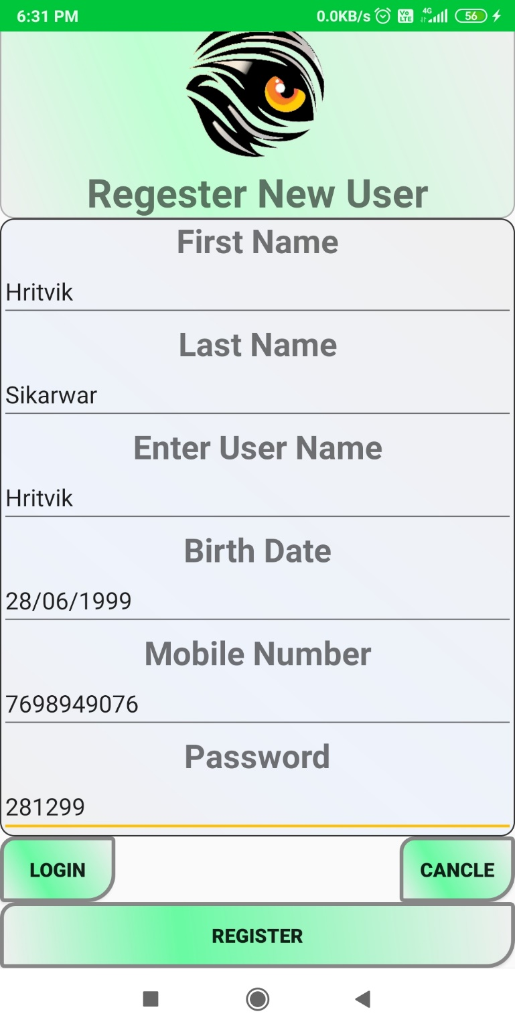
Testing For New User Registration
All the format must match otherwise user cannot register
And a toast popup
“Error”
Error

Slide 45
12.Future Enhancement

Slide 46
We Think that not a Single project is ever considered as Complete forever our mind is always thinking new and our necessities also are growing day by day. We always want something more that what we have. Our Application also, if you see at the first glance that you find it to be complete but we want to make it still mature and fully automatic.
Some are the expansion which we have thought of are :
Try to make system more user friendly
Add in all social media application like Facebook, Twitter, etc.
Send notification on mobile.
Improve searching facilities.
Try to all type of user can use this application

Slide 47
13.Conclustion
All in all We hope that this Application will improve and help to make the work more fast and easy for every one at any time. It will save your time and useful for every user.

Slide 48
14.Bibliography/Reference
During this development of our system, we have taken reference from various Youtube videos, Websites and Online tutors
Websites:
www.google.com
www.codeproject.com
www.youtube.com

Slide 49

Thank You

